Slide 1
Graduation Project Presentation
Group 1

Slide 2
Team member
Moatasem Mohamed Abo Taleb
Mohamed Mahmoud Elteir
Mahmoud Ahmed Elsayed
Mohamed Farrag Abdelhady

Slide 3
Agenda
Project 6: Exploring AWS Identity and Access Management (IAM)
Project 7: Introducing Amazon Elastic File System (Amazon EFS)
Project 8: Creating an Amazon RDS Database
The Problems we faced in the project

Slide 4

What is iam
AWS Identity and Access Management (IAM) is a web service that helps you securely control access to AWS resources. With IAM, you can manage permissions that control which AWS resources users can access

Slide 5

Project 6:Exploring AWS Identity and Access Management (IAM)
In this lab, you will explore AWS Identity and Access Management (IAM) by managing users, groups, and policies within AWS.

Slide 6
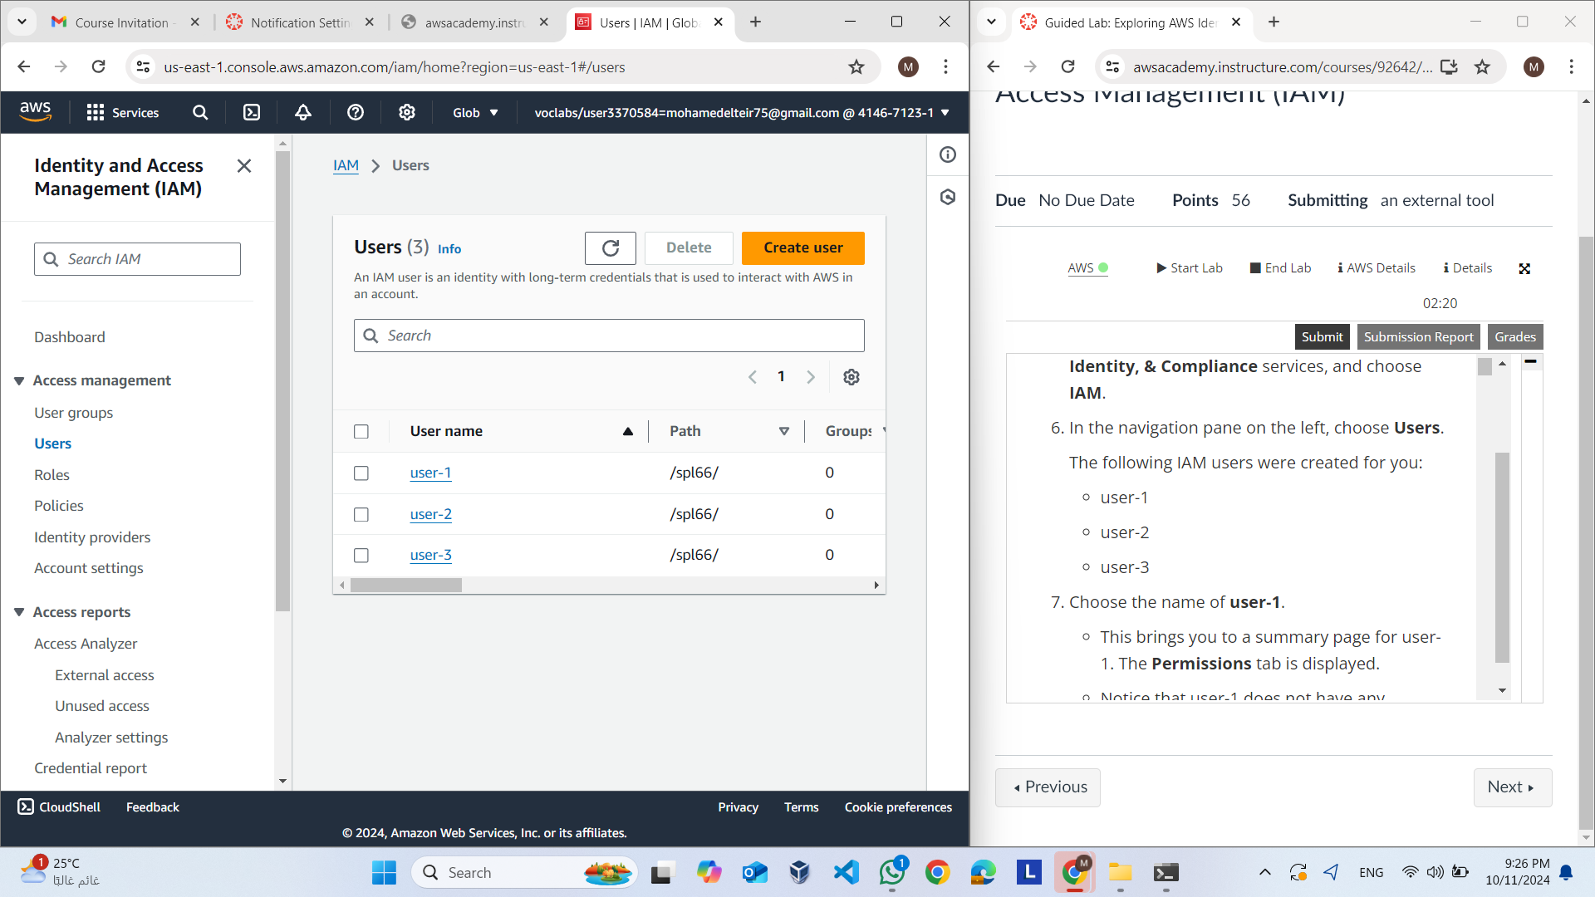
Explore Users and Groups
We must
We must
In this step we should Explore Users and Groups and Inspect the details and permissions associated with each user

Slide 7
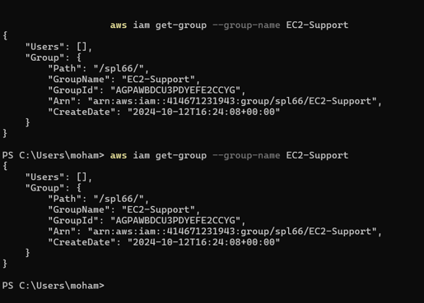
Add Users to Groups
We used cli
In this step we used cli to add :
1- User-1 to S3-Support (Read-only access to S3).
2- User-2 to EC2-2- Support (Read-only access to EC2).
3- User-3 to EC2-Admin (View, Start, and Stop EC2 instances).

Slide 8
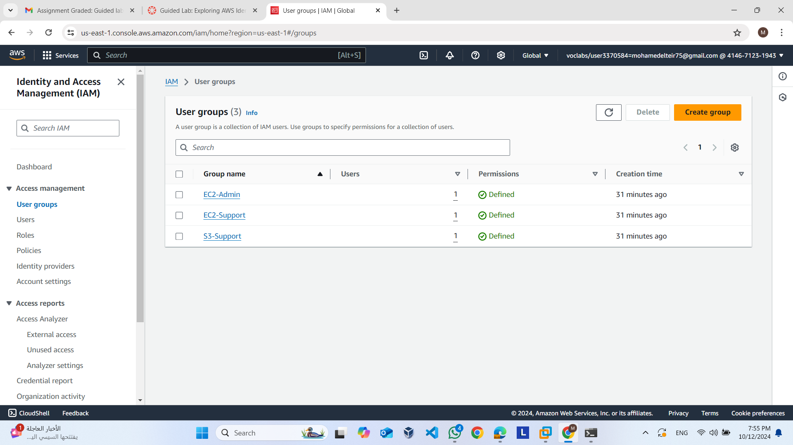
Add Users to Groups
Aws Console explain that users
Added to groups

Slide 9
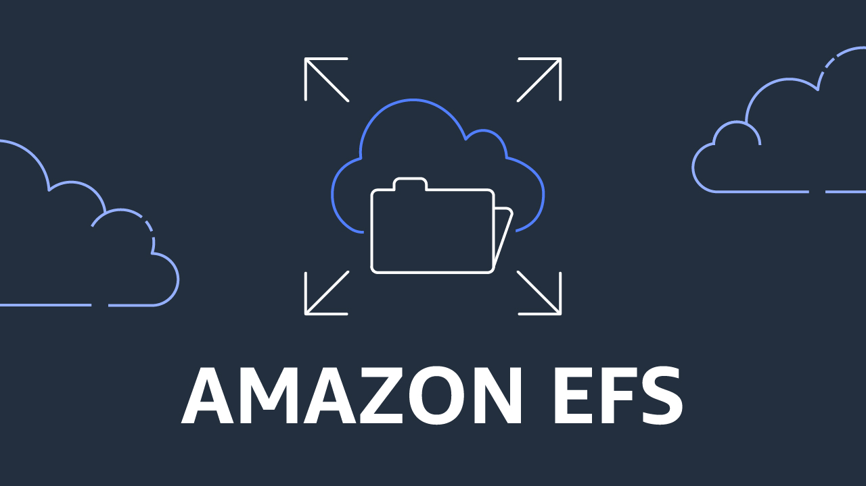
What is EFS
Amazon EFS is a simple, serverless, elastic, set-and-forget file system that automatically grows and shrinks as you add and remove files with no need for management or provisioning

Slide 10
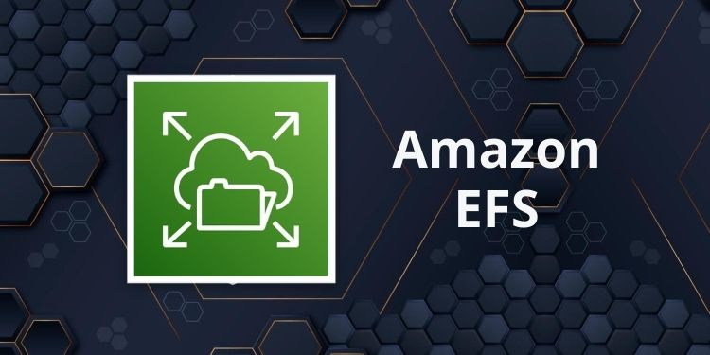
Project 7: Introducing Amazon Elastic File System (Amazon EFS)
This lab introduces you to Amazon Elastic File System (Amazon EFS) using the AWS Management Console and AWS CLI.

Slide 11
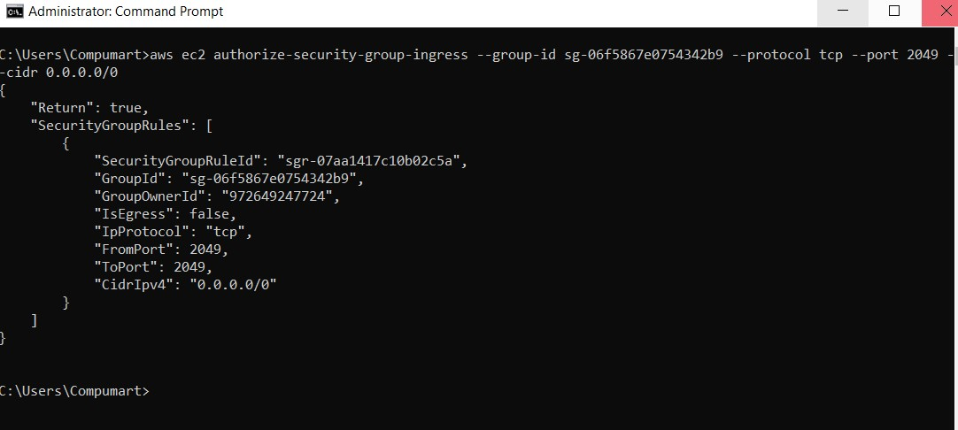
Adding Inbound Rules to Allow Access via NFS
We Create a security group named EFS Mount Target to allow inbound NFS access on port 2049 in cli

Slide 12
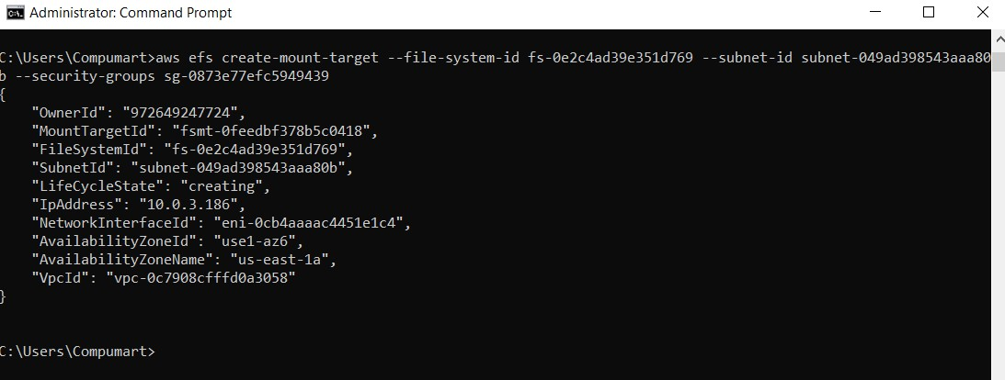
Creating an EFS File System
In this Step we Adding Mount Targets for the EFS File System

Slide 13
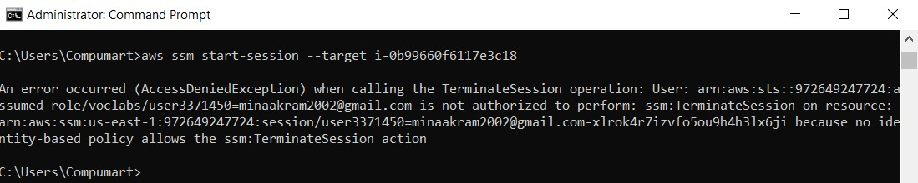
Connecting to the EC2 Instance
Use AWS Systems Manager Session Manager to connect to the EC2 instance that will mount the EFS file system.

Slide 14
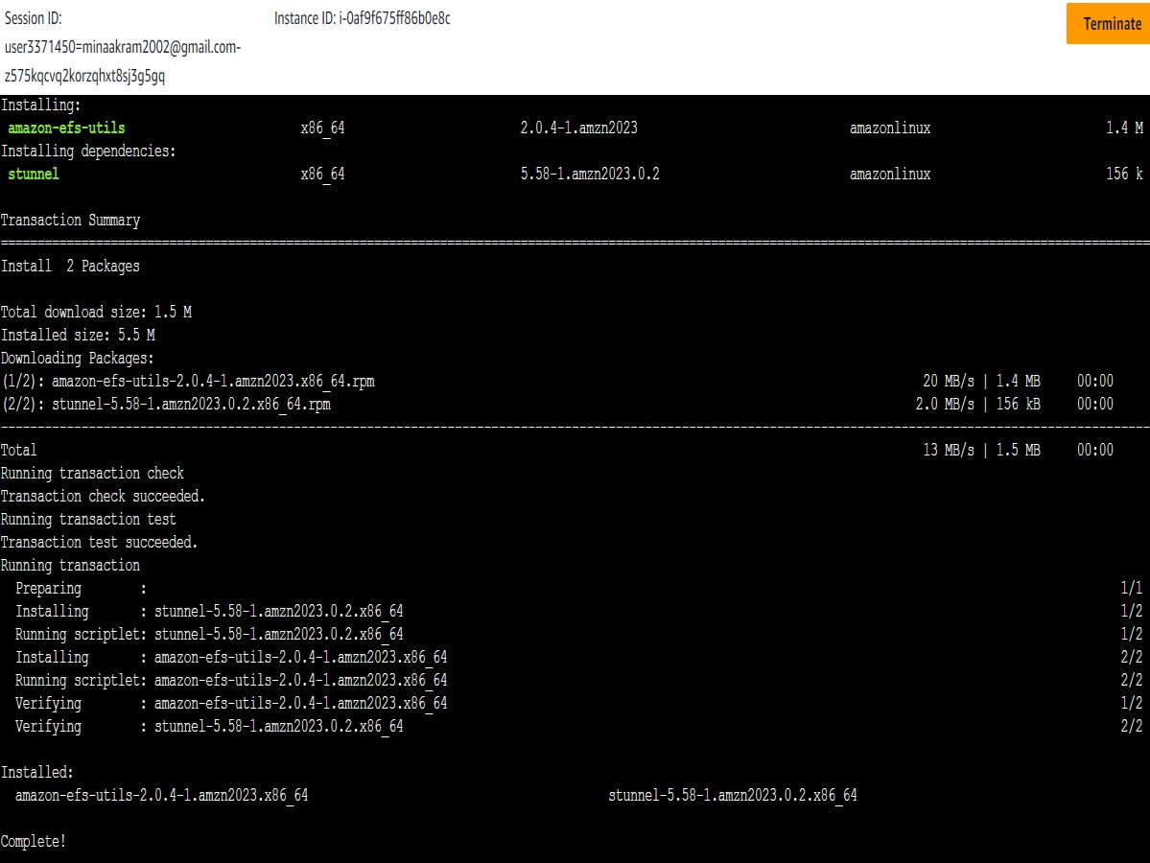
Mounting the EFS File System
In this step we Mount the EFS file system using the provided mount command, ensuring it is properly connected and available to the EC2 instance.

Slide 15
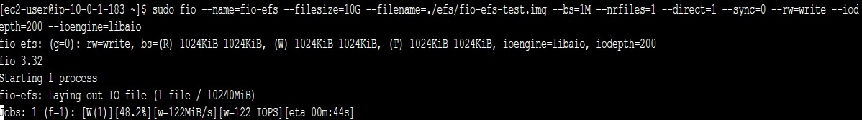
Examining the Performance of the EFS File System
Use the Flexible IO (fio) tool to benchmark the EFS performance on the EC2 instance in cli

Slide 16
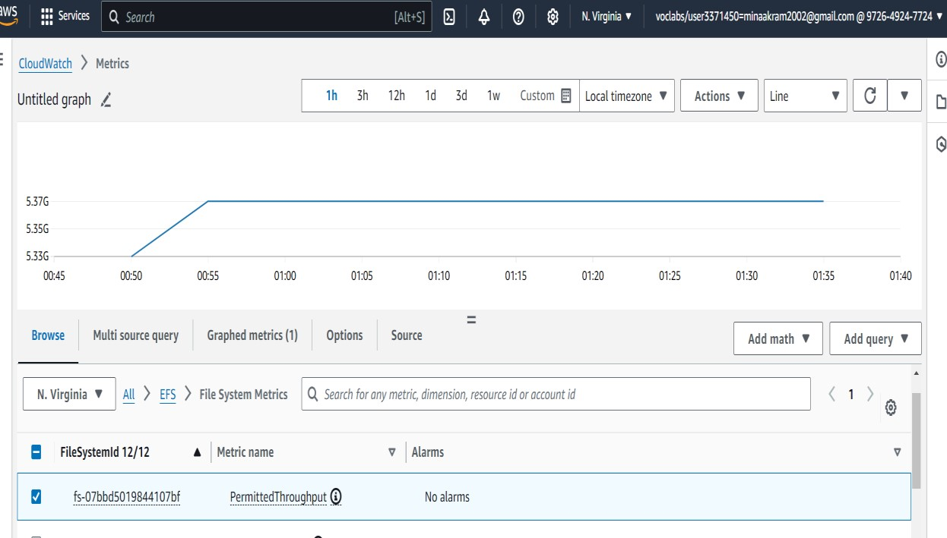
Examining the Performance of the EFS File System
In this step we Monitor the file system's performance using Amazon CloudWatch in AWS Console.

Slide 17

What is Database
AWS databases offer a high-performance, secure, and reliable foundation to power generative AI solutions and data-driven applications that drive value for your business and customers.

Slide 18
Database types
5. Amazon DynamoDB
6. NoSQL databases
7. PostgreSQL
Amazon RDS
Aurora
Amazon Redshift
Amazon Neptun
Amazon RDS
Aurora
Amazon Re
Amazon Neptun
Amazon DynamoDB
NoSQL Databases
PostgreSQL
Kinesis

Slide 19
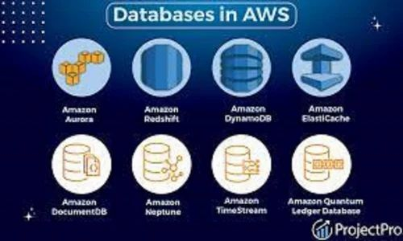
Project 8: Creating an Amazon RDS Database
This lab guides you through the process of creating a relational database using Amazon Relational Database Service (RDS).

Slide 20
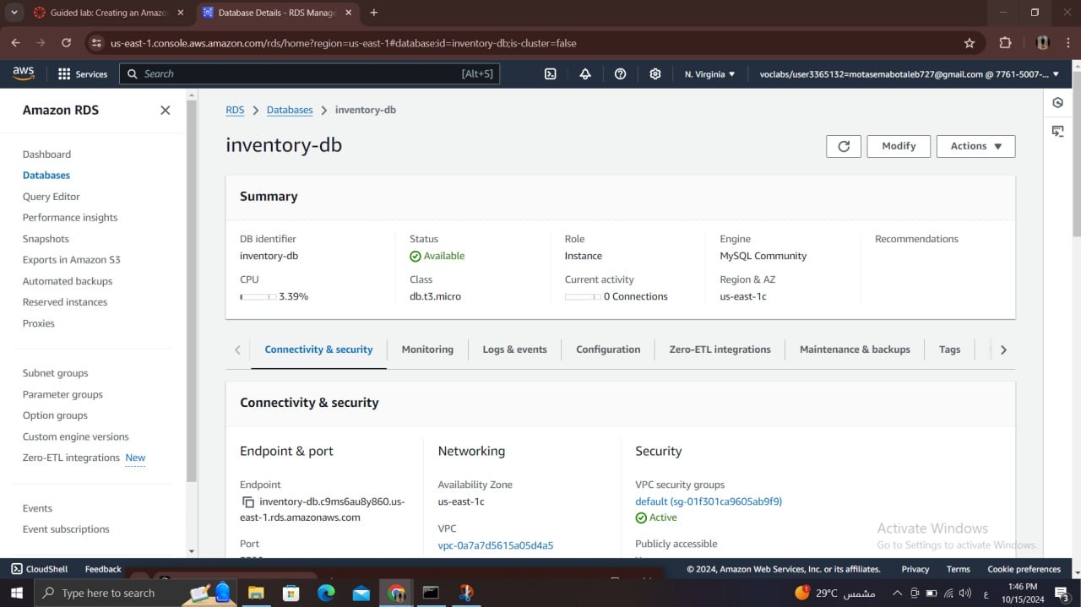
Database Details on Amazon RDS
This image shows the Amazon RDS interface for the database named 'inventory-db'. The overall status of the database is 'Available', indicating it is ready for use. The database is created on a db.t3.micro instance

Slide 21
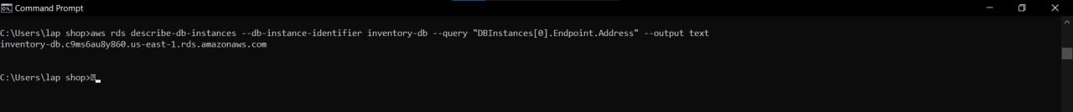
Configuring Web Application Communication with the Database Instance
In this image, the AWS CLI command 'describe-db-instances' is used, which retrieves specific information about the database. Here, the command queries the 'Endpoint.Address' of the database 'inventory-db'.

Slide 22
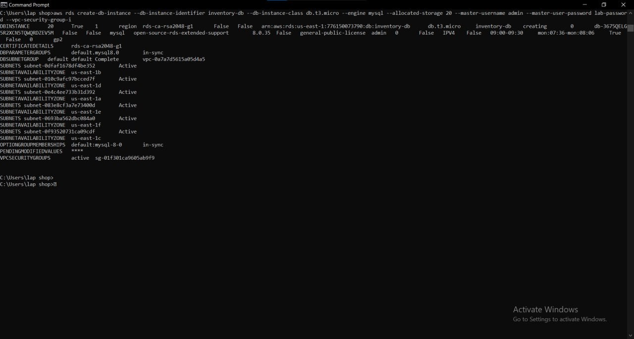
Creating a Database Using AWS CLI
This image demonstrates the use of the 'create-db-instance' command in AWS CLI to create the 'inventory-db' database. A storage allocation of 20 GB is specified, along with defining a master username and password for secure access.

Slide 23
Problems
How to edit a configuration file
How to use cli in the first time

Slide 24

conclusion

